Slide 1
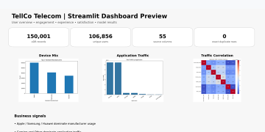
PROJECT PRESENTATION
TELLCO
Telecom User Analytics
From network activity to customer segments
and satisfaction intelligence
PRESENTATION ROADMAP
01 Business Need
02 Data & Quality
03 User Overview
STREAMLIT DASHBOARD PREVIEW
04 Engagement
05 Experience
06 Satisfaction
07 Model
08 Dashboard
09 References
SUBMITTED BY
Rashika Singh
Data Analytics Intern
EDA
K-Means
Satisfaction
ML
Streamlit
NextHikes IT Solutions | Project 5
TellCo Telecom User Analytics • User Overview • Engagement • Experience • Satisfaction
01

Slide 2
01 | Business Need & Scope
The project brief defines four analytical pillars and a dashboard deliverable.
4
Analysis pillars
1 month
xDR window
Web
Dashboard
ML
Segmentation + regression
• Understand customer activity from network-generated xDR data.
• Identify user behavior, engagement, experience and satisfaction patterns.
• Convert analysis into an easy-to-use web dashboard.
• Use the analytical outputs to support business interpretation.
Raw xDR
Clean + EDA
User features
K-Means
Satisfaction
Regression
HOME
TellCo Telecom User Analytics | Nexthikes IT Solutions
2

Slide 3
02 | Data Foundation & Quality
Raw dataset profile and preprocessing focus.
150,001
Rows
55
Columns
106,856
Unique users
0
Exact duplicate rows
QUALITY CHECKPOINTS
✓ Missing-value profiling
✓ Duplicate detection
✓ Numeric conversion
✓ IQR outlier checks
✓ User-level aggregation
• The project report records 1,066 missing user IDs in the raw dataset.
• Several network fields have substantial missingness, including TCP retransmission and HTTP traffic fields.
• The pipeline applies numeric conversion, imputation, duplicate checks and IQR-based outlier treatment.
• Interpretation should account for the one-month observation window.
HOME
TellCo Telecom User Analytics | Nexthikes IT Solutions
3

Slide 4
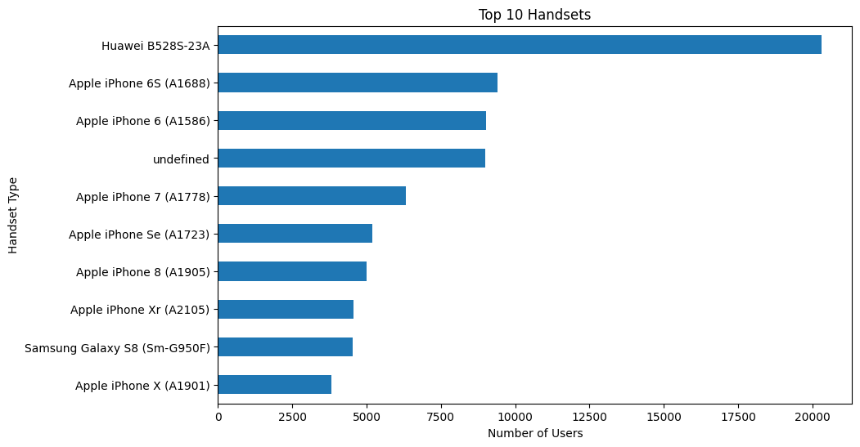
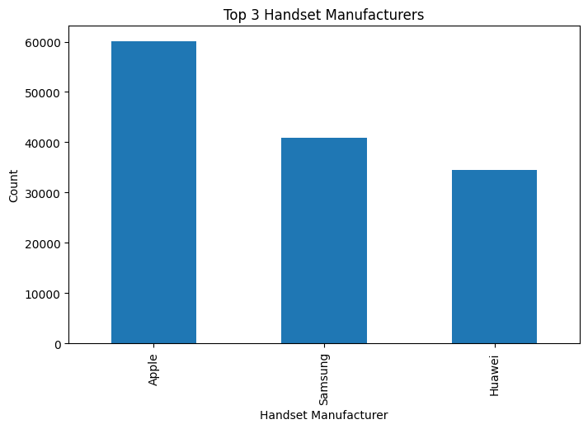
03 | User Overview
Device mix and application behavior establish the customer baseline.
• Top manufacturers: Apple 59,565 | Samsung 40,839 | Huawei 34,423.
• Huawei B528S-23A is the leading handset type in the submitted analysis.
• Device concentration provides context for later behavioral segmentation.
HOME
TellCo Telecom User Analytics | Nexthikes IT Solutions
4

Slide 5
04 | User Engagement
Segmentation of customer activity using frequency, duration and traffic.
3
K-Means clusters
Sessions
Frequency
Duration
Usage time
Traffic
Volume
• Engagement combines xDR session count, session duration and total traffic.
• Features are normalized before clustering.
• K-Means with k=3 is used to create engagement segments.
• Cluster summaries are used to characterize user groups.
• The notebook output contains an extremely small cluster, so that segment should be interpreted cautiously.
Main group
Secondary
Extreme
HOME
TellCo Telecom User Analytics | Nexthikes IT Solutions
5

Slide 6
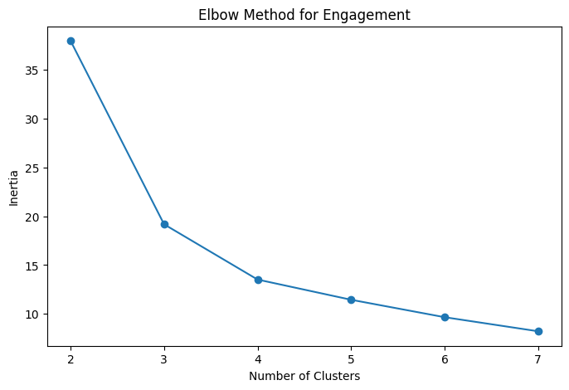
05 | User Experience
Network-quality segmentation using retransmission, latency and throughput.
TCP
Retransmission
RTT
Latency
Throughput
Network speed
• Average TCP retransmission, RTT and throughput are calculated per customer.
• TCP retransmission and RTT are direction-adjusted before clustering.
• K-Means with k=3 creates three experience segments.
• Experience score is based on distance from the cluster identified as the worst experience group.
• Scores should be interpreted together with the underlying network metrics.
HOME
TellCo Telecom User Analytics | Nexthikes IT Solutions
6

Slide 7
06 | User Satisfaction
Combining engagement and experience into a customer-level satisfaction view.
Engagement Score + Experience Score → Satisfaction Score → K-Means (k=2)
• Satisfaction is constructed from the engagement and experience scores.
• Two satisfaction clusters are created using K-Means.
• A very large score of 260.56 appears against other top values around 2.6–2.7.
• This outlier materially affects the interpretation of the satisfaction segmentation.
260.56
largest reported satisfaction score
HOME
TellCo Telecom User Analytics | Nexthikes IT Solutions
7

Slide 8
07 | Satisfaction Prediction
Regression comparison and the main modeling limitation.
Hist Gradient Boosting
Tracked final model
0.02229
MAE
1.93562
RMSE
0.06704
R²
• Hist Gradient Boosting has the highest observed R² in the submitted model comparison.
• Training: 72,029 samples | Testing: 18,008 samples.
• Model artifact: satisfaction_model.pkl.
• R² = 0.06704 is low, indicating limited explanatory power for the constructed satisfaction score.
• More predictive behavioral/network/customer features would be needed for stronger performance.
Model | MAE | RMSE | R²
Hist Gradient Boosting | 0.022 | 1.936 | 0.067
Extra Trees | 0.017 | 1.936 | 0.067
Random Forest | 0.019 | 1.936 | 0.066
Gradient Boosting | 0.031 | 1.936 | 0.066
Linear Regression | 0.241 | 10.150 | -24.655
HOME

Slide 9
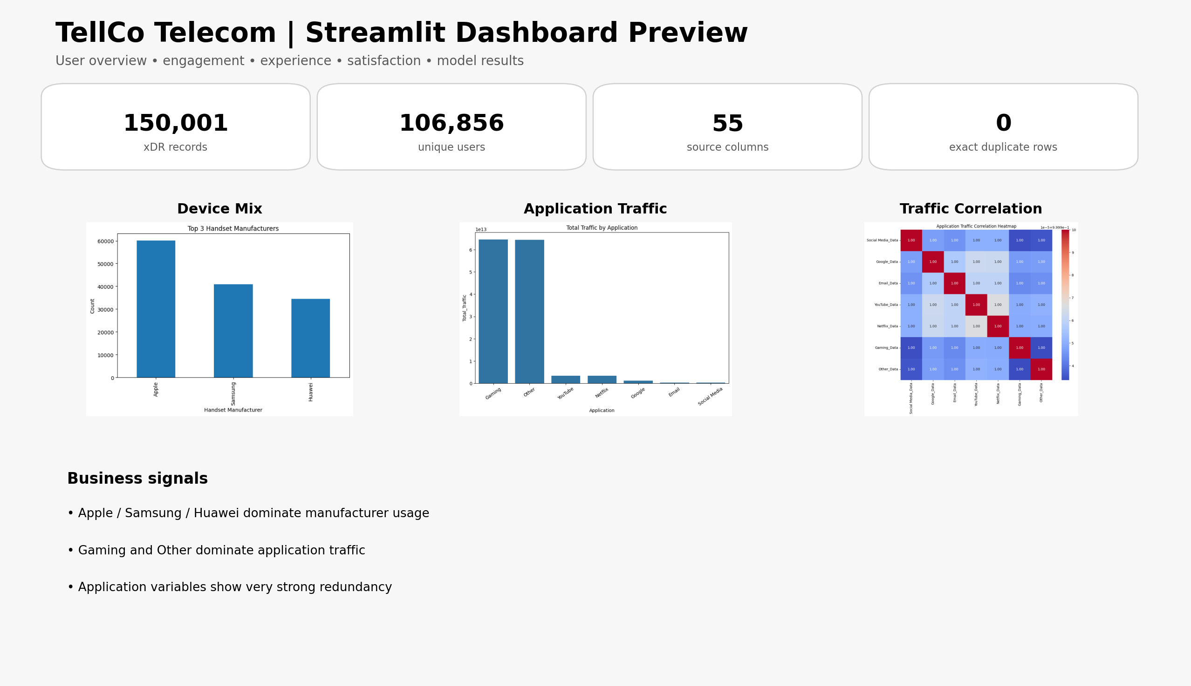
08 | Interactive Dashboard
One consolidated dashboard view — no repeated dashboard pages.
HOME
TellCo Telecom User Analytics | Nexthikes IT Solutions
9

Slide 10
09 | References & Source Material
Materials used as the basis of the project and presentation.
1. Nexthikes IT Solutions — “User Analytics in the Telecommunication Industry” project brief.
2. TellCo Telecom User Analytics — project report / complete Python implementation.
3. Submitted notebook — project_5_final.ipynb.
4. Scikit-learn documentation — clustering, PCA and regression methods.
5. Streamlit documentation — dashboard application framework.
scikit-learn.org/stable/modules/clustering.html
scikit-learn.org/stable/modules/decomposition.html
docs.streamlit.io/
HOME
TellCo Telecom User Analytics | Nexthikes IT Solutions
10

Slide 11
Conclusion
The analytical story in six points.
Clean, structured xDR data provides the foundation for customer analytics.
Device and application analysis reveals concentrated usage patterns.
Engagement clustering converts usage intensity into customer segments.
Experience clustering captures network-quality differences using TCP, RTT and throughput.
Satisfaction combines both dimensions, but the extreme outlier must be disclosed.
The final tracked model is Hist Gradient Boosting; its low R² highlights the need for richer predictive features.
HOME
TellCo Telecom User Analytics | Nexthikes IT Solutions
11

Slide 12
Thank You

